Slide 1

Lighting Up the Streets: Building a Traffic Light System with PIC16F877A and 7-Segment Display

Slide 2

Introduction
.Components Used
.connection of common anode seven segment
.Circuit Design
.Code Implementation
.Conclusion

Slide 3

introduction
Welcome to this presentation on the traffic light system. Traffic management is a crucial aspect of urban planning and development, and efficient traffic light systems play a vital role in ensuring the smooth flow of vehicles and pedestrians on roads.
The purpose of this presentation is to provide an overview of the components used in the traffic light system, the circuit design, code implementation, and a live demonstration of its functionality. We will also discuss the importance of implementing efficient traffic management systems in urban areas.

Slide 4

Component used
The traffic light system is composed of several key components that work together to manage traffic flow efficiently. One of the most important components is the PIC16F877A microcontroller, which acts as the brain of the system. It processes the input signals and controls the output signals to ensure that the traffic lights change at the right time.
Another crucial component is the common anode seven segment display, which is used to display the countdown timer for each traffic light. This allows drivers and pedestrians to know exactly how much time they have left before the light changes. The 7447 IC decoder is also a vital part of the system, as it converts the binary code from the microcontroller into a format that can be displayed on the seven segment display.

Slide 5

connection of Common Seven Segment with 7447 Decoder
common Seven Segment Display
A common seven segment display is a type of electronic display device that is used to display decimal numerals.

Slide 6
7447 Decoder
The 7447 decoder is a BCD to seven segment decoder IC that is used to convert binary coded decimal (BCD) into the seven segment display format.

Slide 7
connection
To connect a common seven segment display with a 7447 decoder, connect the BCD inputs (A, B, C, D) of the decoder to the BCD output of the microcontroller or other digital device. Then, connect the seven segment display to the outputs (a, b, c, d, e, f, g) of the decoder. The common pin of the seven segment display should be connected to the common pin of the decoder.

Slide 8

Code implementation
The code implementation of the traffic light system is a crucial aspect of its functionality. Using MikroC software, we were able to program the PIC16F877A microcontroller to control the sequence of the traffic lights. The code utilizes a series of if-else statements to determine which light should be on at any given time.
Additionally, the code includes a timer function to ensure that each light stays on for the appropriate amount of time before switching to the next one. This helps to regulate traffic flow and prevent accidents. Overall, the code implementation is integral to the success of the traffic light system.

Slide 9


Slide 10


Slide 11
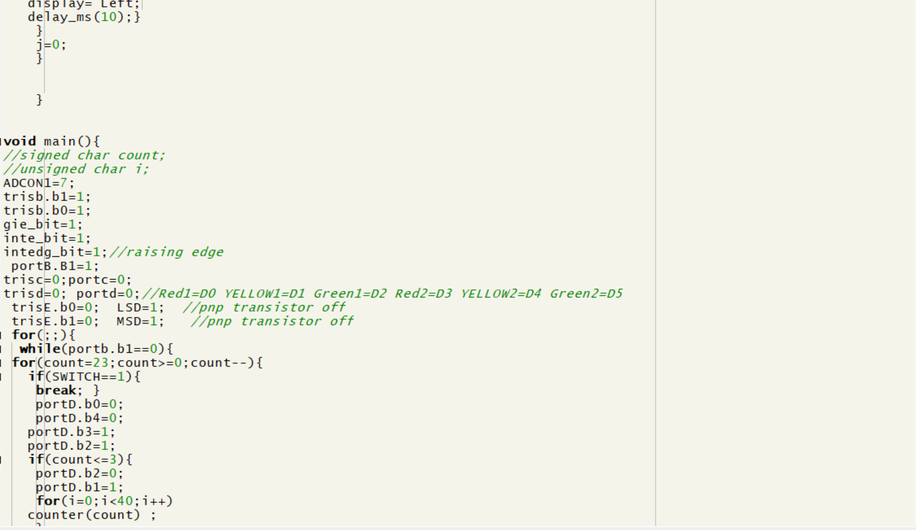

Slide 12


Slide 13
Circuit Design
The circuit design of the traffic light system consists of several components, including the PIC16F877A microcontroller, the common anode seven segment display, and the 7447 IC decoder. These components work together to control the sequence of the traffic lights and display the appropriate signals to drivers and pedestrians.
To create the circuit diagram, we used Proteus software, which allowed us to simulate the behavior of the system before building it in real life. The connections between the components are carefully designed to ensure that the traffic lights operate correctly and efficiently.

Slide 14
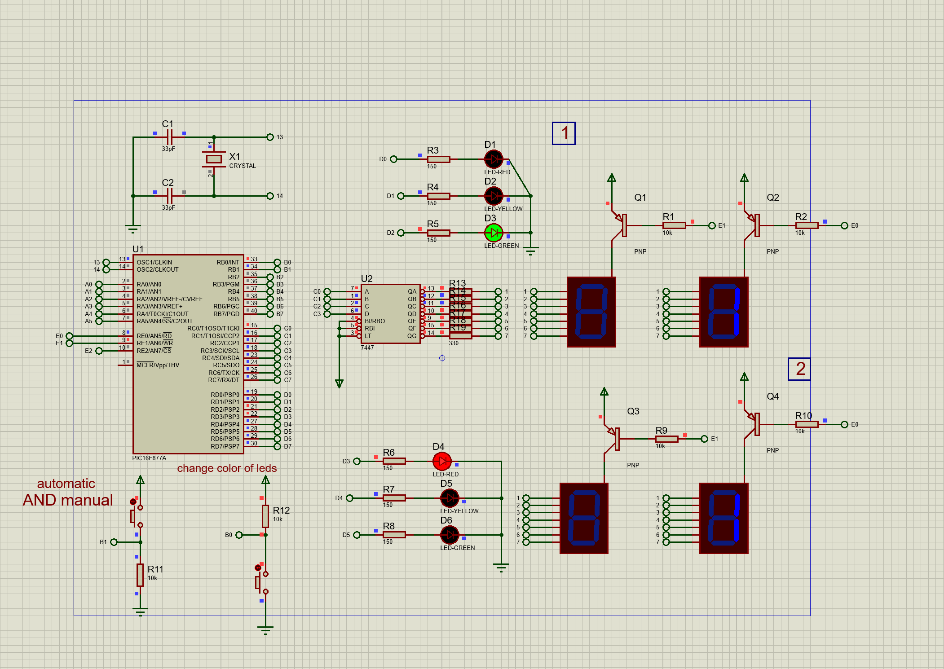

Slide 15
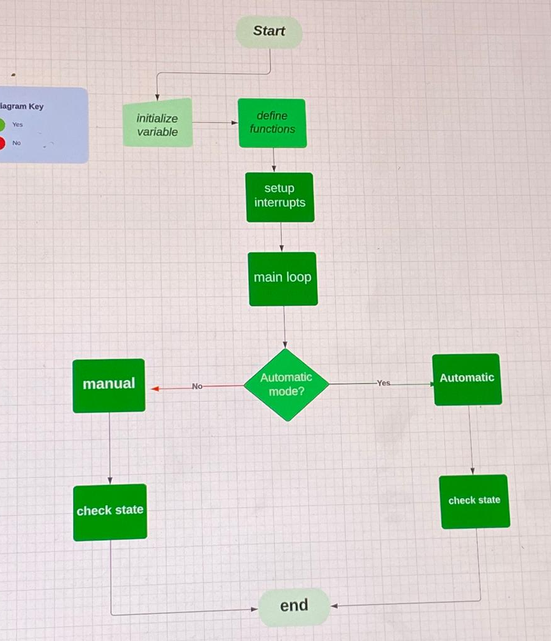
Simple flowchart

Slide 16
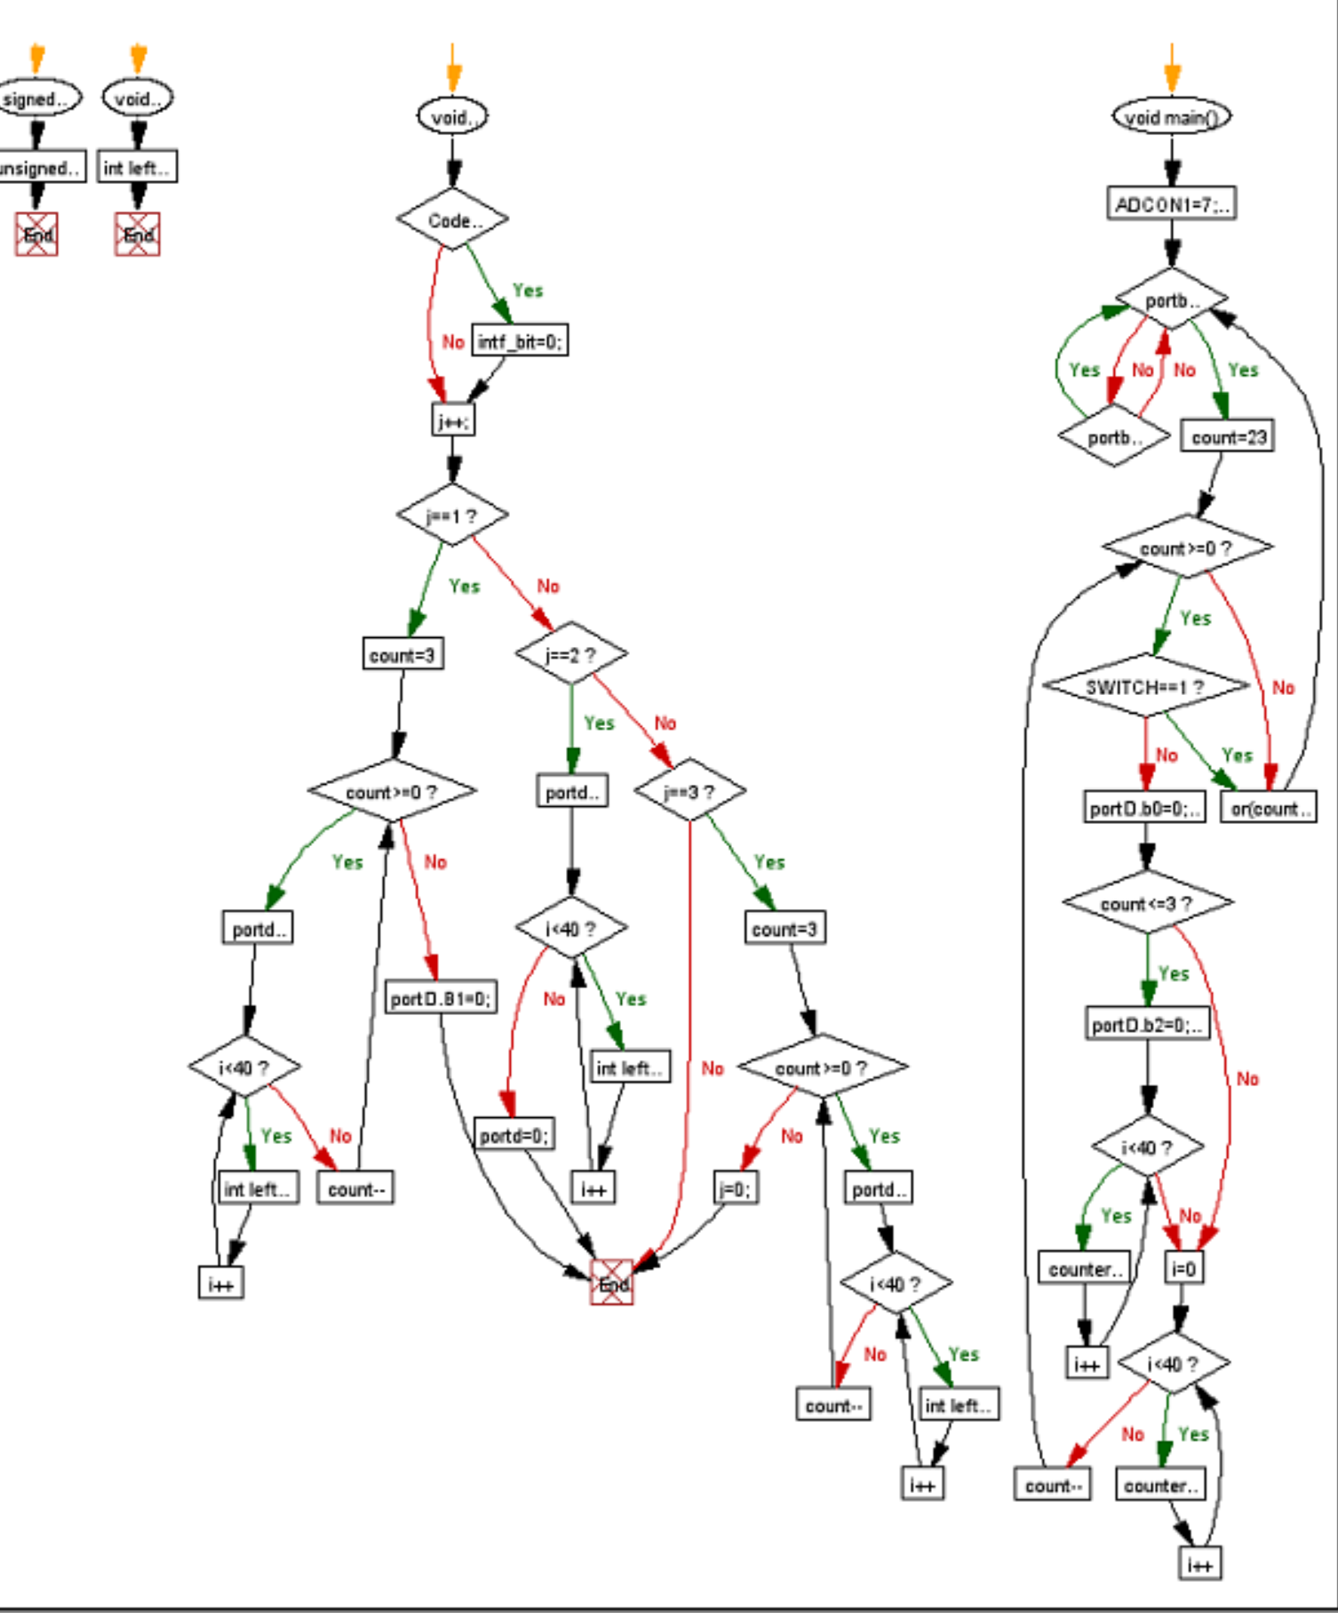

Slide 17

conclusion
In conclusion, we have explored the components and circuit design of a traffic light system using a PIC16F877A microcontroller and a common anode seven segment display with a 7447 IC decoder. We have also discussed the code implementation of the system using MikroC software and demonstrated its effectiveness in managing traffic flow.
It is important to note that efficient traffic management systems are crucial in urban areas to prevent congestion and accidents. By implementing such systems, we can reduce travel time and improve overall safety for both drivers and pedestrians.

